Slide 1
StageNet: Stage-Aware Neural Networks for Health Risk Prediction
CS 598 Deep Learning for Healthcare Final Project
By: Sean Lai and Tyler Wong
Project Repo: https://github.com/T-Wong/CS598_DLH_Final_Project
Group ID: 36
Paper ID: 182

Slide 2
Stage-Aware Neural Networks for Health Risk Prediction
StageNet is a novel approach for predicting health risks of patients in healthcare using machine learning and artificial intelligence techniques.
StageNet incorporates temporal dynamics and progression stages of patients' conditions to offer a more accurate and effective prediction model.
The main contribution of StageNet is its stage-aware neural network architecture that leverages the information of different disease stages to enhance health risk prediction.

Slide 3
StageNet Challenge: Enhancing Health Risk Prediction
This model uses temporal dynamics and progression stages of patients' conditions into health risk prediction, which is often overlooked by conventional methods.
Dealing with the varying patterns and complexities in patient data, which can be challenging to account for using traditional methods.
Adapting to the non-linear and time-varying nature of health data to offer improved predictive performance.
Enabling clinicians and healthcare providers to make better-informed decisions for patient care by providing more accurate and effective health risk predictions.

Slide 4
Project Goals and Claims
Our main goal is to prove that StageNet model will score a significantly higher F1-score, accuracy, AUC, and min(+P, Se) than other modern LSTM based models, specifically. T-LSTM and ON-LSTM.
We will run these models on the MIMIC-III dataset and compare the results.

Slide 5
Reproduction Plan and Walkthrough
Acquire the MIMIC-III dataset from https://mimic.physionet.org/.
Generate a decompensation prediction task for the MIMIC-III benchmark dataset using the repository referenced by the author, which is publicly accessible on https://github.com/YerevaNN/mimic3-benchmarks/.
Load the MIMIC-III decompensation data to the StageNet data directory.
Execute the training command provided by the author to generate StageNet sampling outcomes.
Utilize author’s referenced repositories for T-LSTM and ON-LSTM models (Inci M. Baytas, 2017, and Shen et al., 2018, respectively).
Clone the code and run these models on the same dataset to get result comparison.
Use a modern Nvidia GPU to run the training since training is expected to be resource heavy.
Please refer to more details such as hyperparameters in our report.

Slide 6
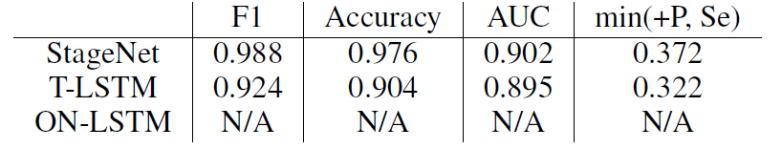
Results Comparison
StageNet Results:
accuracy = 0.9766005873680115
precision class 0 = 0.9877837896347046
precision class 1 = 0.378338098526001
recall class 0 = 0.9883724451065063
recall class 1 = 0.366655558347702
AUC of ROC = 0.9027237860494428
AUC of PRC = 0.3374715298096852
min(+P, Se) = 0.3722376457523598
Result Comparisons

Slide 7
What was easy?
The StageNet model's extensive documentation and helpful examples made our experience with it relatively smooth.
We were able to generate a decompensation dataset from another repository referenced by the StageNet repository by following the excellent documentation and examples provided.
We faced little challenges during the installation of required Python modules and had to modify the code based on the hardware environment.
Running the StageNet code did not take up much of our time compared to other models due to the comprehensive and well-documented README, which made it easier to navigate the codebase and understand the underlying algorithms.
The hyperparameters were easy to manipulate for testing purposes, which was an added plus.

Slide 8
What was difficult?
For ON-LSTM, we spent many GPU hours training the model to the minimum epochs required. However, the data required to continue training the model was behind a paywall, and we could not continue without spending money.
Most of our time was spent trying to gather results from the T-LSTM and ON-LSTM models, which were separate repositories referenced by the author.
We encountered many inconveniences while working with T-LSTM and ON-LSTM, which took longer than expected.
With T-LSTM, we had to play around with the code and debug a few items to get the results we wanted. We had to update the code to get the F1 score we needed for our claim.
T-LSTM required using Python 2.7, which has been sunsetted in favor of Python 3, so getting the required libraries took extra effort.
The heavy GPU requirements of T-LSTM and ON-LSTM made training the models time-consuming and resource-intensive compared to StageNet, where we had access to pre-trained models.
Training times for T-LSTM and ON-LSTM were not captured in our proposal, and we spent many GPU hours training the data for this experiment.

Slide 9
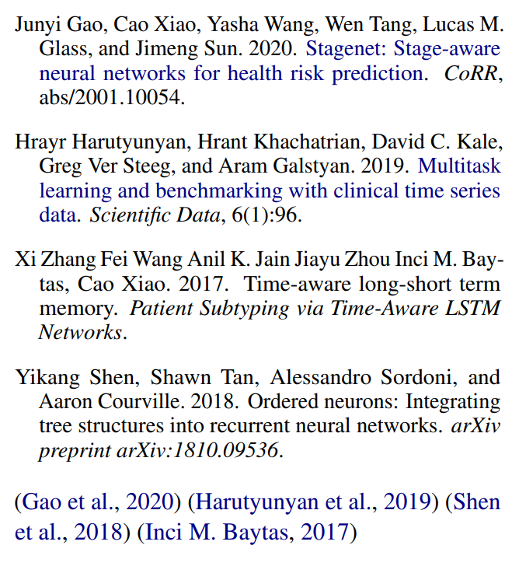
References

